Slide 1
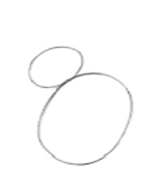
1
Draw 2 circles

Slide 2
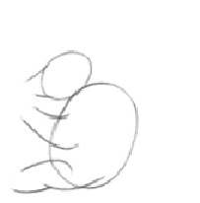
2
Add the nose and legs

Slide 3
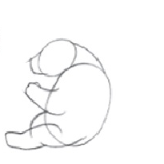
3
Draw the outline of the panda

Slide 4
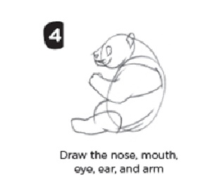
4
Draw the nose, mouth, eye, ear, and arm

Slide 5
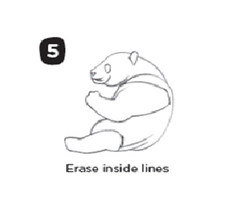
5
Erase inside lines

Slide 6
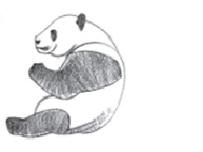
6
Add shading

